Slide 1
Ordering fractions by converting
Comparing and ordering fractions and decimals (positive and negative)

Slide 2
how to use Oak lessons

Slide 3
I can compare and order fractions by converting to decimals.

Slide 4
A number is in decimal form when the decimal point is shown and there are digits to the right of the decimal point.
Numerator − The expression in a fraction that is written above the fraction line. It is the dividend.
Denominator − The expression in a fraction that is written below the fraction line. It is the divisor.

Slide 5

Ordering fractions by converting
Reviewing converting fractions to decimals
Ordering fractions by converting into decimals

Slide 6


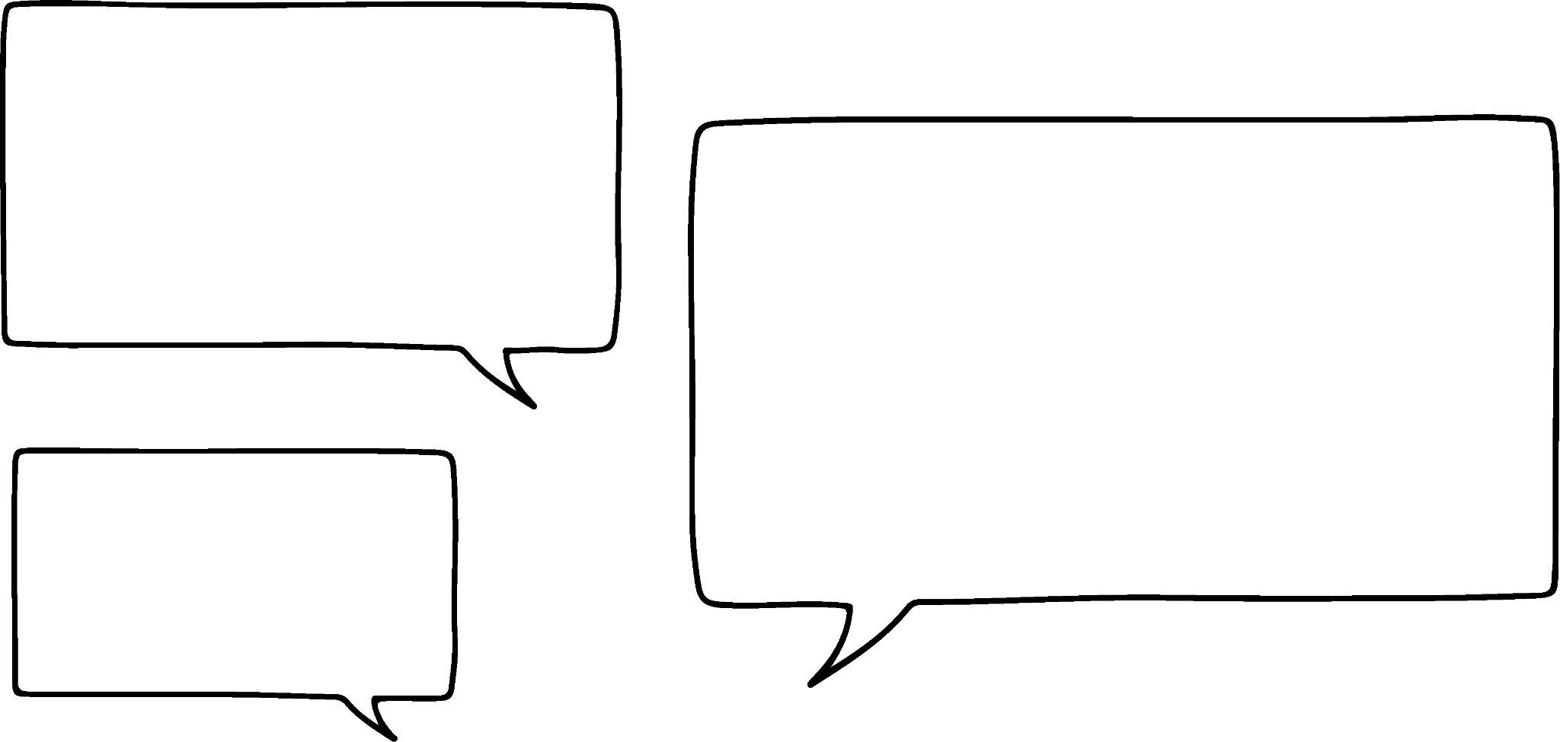


Reviewing converting fractions to decimals
0 . 4
2
5
2 .
0
Remember this is equivalent to 1
Why did you
I needed to make the denominator 10, 100 or 1000 to use the place value chart.
I am going to try your method next time.
multiply
by
?
Jun
Laura

Slide 7


Reviewing converting fractions to decimals
Convert
to a decimal.
What do I do here? I can’t make the denominator 10 as that would give a decimal numerator.
Remember I said, make the denominator 10, 100 or 1000.
I recommend 100 but only because I think it is easier.
Oh, yes. I can make the denominator 100 or 1000.
Jun
Laura

Slide 8

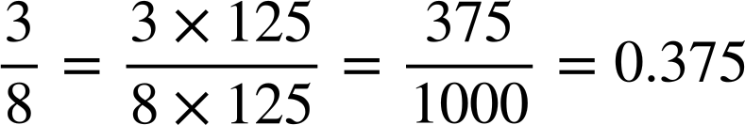
Reviewing converting fractions to decimals
Convert
to a decimal.
8 is not a factor of 10 or 100 so it will have to be 1000.
What denominator will we use here?
Jun
Laura

Slide 9

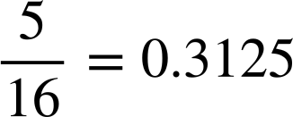
Reviewing converting fractions to decimals
Convert
to a decimal.
1 × 16 = 16
2 × 16 = 32
3 × 16 = 48
4 × 16 = 64
5 × 16 = 80
0 .
3
1
2
5
5
2
0
4
0
8
0
16
5 .
0
We can’t make the denominator 10, 100 or 1000. What do we do now?
Now we need to use my original method.
Jun
Laura

Slide 10





Reviewing converting fractions to decimals
Which of the following would you use the short division method on to convert to a decimal?

Slide 11


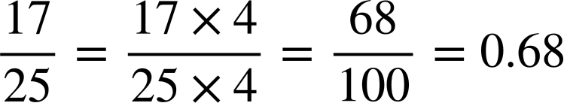
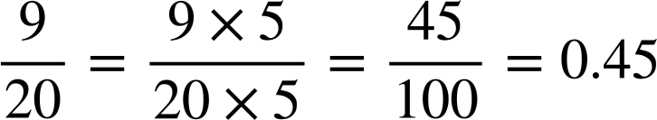
Reviewing converting fractions to decimals
Convert
to a decimal.
Convert
to a decimal.

Slide 12


Reviewing converting fractions to decimals
Convert
to a decimal.
Convert
to a decimal.
0 .
2
1
8
7
5
0 .
5
6
2
5
7
6
28
24
16
9
10
4
8
32
7 .
0
16 9 . 0
0
0
0
0
0
0
0
1 × 32 = 32
2 × 32 = 64
3 × 32 = 96
4 × 32 = 128
5 × 32 = 160
6 × 32 = 192
7 × 32 = 224
8 × 32 = 256
9 × 32 = 288
10 × 32 = 320
1 × 16 = 16
2 × 16 = 32
3 × 16 = 48
4 × 16 = 64
5 × 16 = 80
6 × 16 = 96
7 × 16 = 112
8 × 16 = 128
9 × 16 = 144
10 × 16 = 160

Slide 13












Reviewing converting fractions to decimals
Identify the mistakes in this puzzle and correct them.
Each fraction should meet up with its decimal equivalent.
0.15
0.635
0.34
0.6
0.36
0.35
0.2
0.012
0.05
0.65
0.5
0.22
0.7
0.68

Slide 14
Reviewing converting fractions to decimals
Identify the mistakes in this puzzle and correct them.
Each fraction should meet up with its decimal equivalent.
0.625
0.15
0.635
0.34
0.68
0.6
0.8
0.36
0.35
0.25
0.2
0.12
0.012
0.05
0.65
0.5
0.55
0.22
0.7
0.68

Slide 15
Ordering fractions by converting
Reviewing converting fractions to decimals
Ordering fractions by converting into decimals

Slide 16
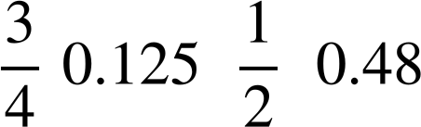
Ordering fractions by converting into decimals
Write these fractions and decimals in ascending order.
We know that is bigger than and 0.48 is smaller than
I can do this. I am going to change the fractions into decimals to make it easier.
I don’t think you need to.
Jun
Laura

Slide 17
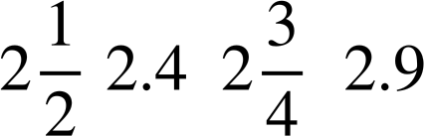
Ordering fractions by converting into decimals
Write these fractions and decimals in ascending order.
Greater than
Less than

Slide 18
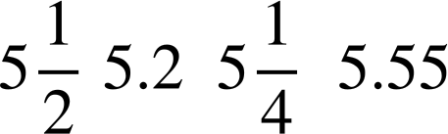
Ordering fractions by converting into decimals
Write these fractions and decimals in ascending order.
Less than
Greater than

Slide 19
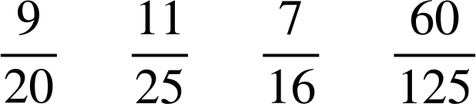
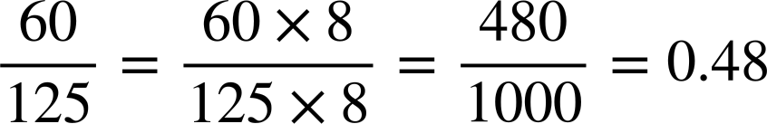
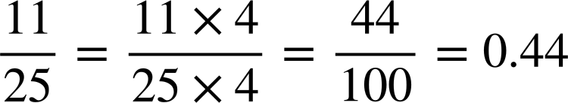
Ordering fractions by converting into decimals
If it is not obvious, you may need to convert the fractions into decimals.
1 × 16 = 16
2 × 16 = 32
3 × 16 = 48
4 × 16 = 64
5 × 16 = 80
6 × 16 = 96
7 × 16 = 112
8 × 16 = 128
9 × 16 = 144
10 × 16 = 160
Order the following:
In order as decimals:
0.4375,
0.44,
0.45,
0.48
0 .
4
3
7
5
In order as fractions:
7
6
12
8
16 7 . 0
0
0
0

Slide 20
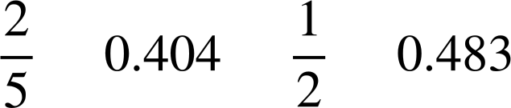
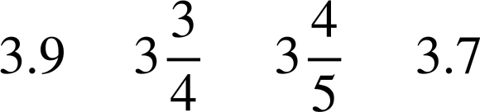
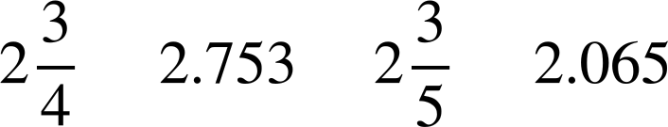
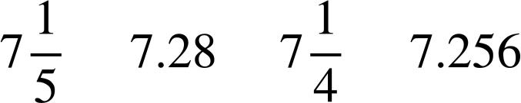
Ordering fractions by converting into decimals
Write the following in ascending order.
a)
c)
b)
d)

Slide 21
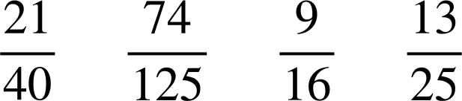
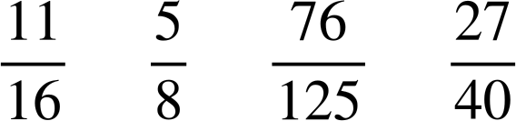
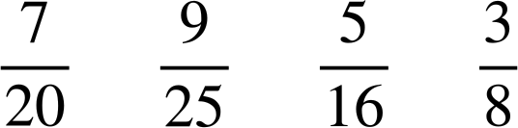
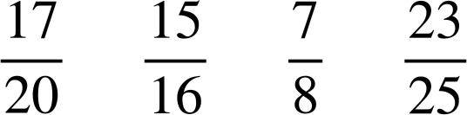
Ordering fractions by converting into decimals
2) Convert the following into decimals and then write them in ascending order.
a)
c)
b)
d)

Slide 22
Ordering fractions by converting into decimals
Write the following in ascending order.
a)
c)
b)
d)

Slide 23
Ordering fractions by converting into decimals
2) Convert the following into decimals and then write them in ascending order.
a)
= 0.52
= 0.525
= 0.5625
= 0.592
b)
= 0.3125
= 0.35
= 0.36
= 0.375
c)
= 0.608
= 0.6875
= 0.625
= 0.675
d)
= 0.85
= 0.875
= 0.92
= 0.9375

Slide 24
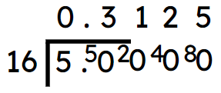
Ordering fractions by converting
Fractions with a denominator which is a factor of 10, 100 and 1000 can be converted to decimals by using equivalent fractions.
E.g.
Other fractions can be converted to decimals using short division.
E.g.
It is not always necessary to convert fractions to decimals to order them.
Writing a fraction as a decimal can help with ordering fractions.

Slide 25

© Oak National Academy 2023.
Produced in partnership with Mathematics in Education and Industry.
Licensed on the Open Government Licence v3.0, except where otherwise stated. See Oak terms and conditions.

